Slide 1

Managerial Decision Making

Slide 2

Economic Decision Making
Decision making is not easy
It must be done amid
  ever-changing factors
  unclear information
  conflicting points of view
Manager’s Challenge: Tupperware

Slide 3
Economic
Decision Making
Decision Characteristics
Decision-making Models
Steps Executives Take Making Important Decisions
Participative Decision Making
Techniques for Improving Decision Making in Today’s Organizations

Slide 4
Decisions and Decision Making
Decision = choice made from available alternatives
Decision Making = process of identifying problems and opportunities and resolving them

Slide 5
Categories of Decisions
Programmed Decisions
  Situations occurred often enough to enable decision rules to be developed and applied in the future
  Made in response to recurring organizational problems
Nonprogrammed Decisions – in response to unique, poorly defined and largely unstructured, and have important consequences to the organization
Ethical Dilemma: The No-Show Consultant

Slide 6
Decisions and Decision Making
Many decisions that managers deal with every day involve at least some degree of uncertainty and require nonprogrammed decision making
  May be difficult to make
  Made amid changing factors
  Information may be unclear
  May have to deal with conflicting points of view

Slide 7
Certainty, Risk, Uncertainty, Ambiguity
Certainty
  all the information the decision maker needs is fully available
Risk
  decision has clear-cut goals
  good information is available
  future outcomes associated with each alternative are subject to chance
Uncertainty
  managers know which goals they wish to achieve
  information about alternatives and future events is incomplete
  managers may have to come up with creative approaches to alternatives
Ambiguity
  by far the most difficult decision situation
  goals to be achieved or the problem to be solved is unclear
  alternatives are difficult to define
  information about outcomes is unavailable

Slide 8
Selecting a Decision Making Model
Depends on the manager’s personal preference
Whether the decision is programmed or non-programmed
Extent to which the decision is characterized by risk, uncertainty, or ambiguity

Slide 9
Three Decision-Making Models
Classical Model
Administrative Model
Political Model

Slide 10
Classical Model
Logical decision in the organization’s best economic interests
Assumptions
Decision maker operates to accomplish goals that are known and agreed upon
Decision maker strives for condition of certainty – gathers complete information
Criteria for evaluating alternatives are known
Decision maker is rational and uses logic
Normative = describes how a manager should and provides guidelines for reaching an ideal decision

Slide 11
Administrative
Model
Herbert A. Simon
How nonprogrammed decisions are made--uncertainty/ambiguity
Two concepts are instrumental in shaping the administrative model
  Bounded rationality: people have limits or boundaries on how rational they can be
  Satisficing: means that decision makers choose the first solution alternative that satisfies minimal decision criteria

Slide 12
Administrative Model
How nonprogrammed decisions are made--uncertainty/ambiguity
Managers actually make decisions in difficult situations characterized by non-programmed decisions, uncertainty, and ambiguity
Decision goals often are vague, conflicting and lack consensus among managers;
Rational procedures are not always used
Managers’ searches for alternatives are limited
Managers settle for a satisficing rather than a maximizing solution
intuition, looks to past experience
Descriptive = how managers actually make decisions--not how they should

Slide 13
Political Model
Closely resembles the real environment
Closely resembles the real environment in which most managers and decision makers operate
Useful in making non-programmed decisions
Decisions are complex
Disagreement and conflict over problems and solutions are normal
Coalition = informal alliance among manages who support a specific goal

Slide 14
Characteristics of Classical, Political, and Administrative Decision Making Models
Classical Model Administrative Model Political Model
Clear-cut problem and goals Vague problem and goals Pluralistic; conflicting goals
Condition of certainty Condition of uncertainty Condition of uncertainty/ambiguity
Full information about Limited information about Inconsistent viewpoints; ambiguous
alternatives and their outcomes Alternatives and their outcomes information
Rational choice by individual Satisficing choice for resolving Bargaining and discussion among
for maximizing outcomes problem using intuition coalition members

Slide 15
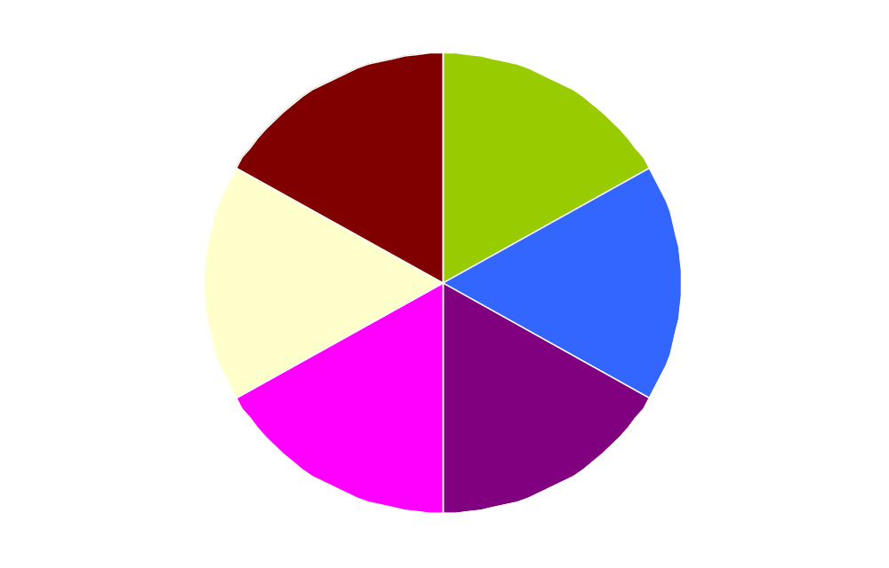
Six Steps in the Managerial
Decision-Making Process
❻
❶
Evaluation
and
Feedback
Recognition of
Decision
Requirement
❷
Implementation
of Chosen
Alternative
Diagnosis
and Analysis
of Causes
Decision-Making
Process
❺
❺
❺
Selection of
Desired
Alternative
Development of
Alternatives
❸
❹

Slide 16
Diagnosis and Analysis of Causes
Diagnosis = analyze underlying causal factors associated with the decision situation
Managers make a mistake if they jump into generating alternatives without first exploring the cause of the problem more deeply

Slide 17
Underlying Causes - Kepner /Tregoe
What is the state of disequilibrium affecting us?
When did it occur?
Where did it occur?
How did it occur?
To whom did it occur?
What is the urgency of the problem?
What is the interconnectedness of events?
What result came from which activity?

Slide 18
Selection of Desired Alternatives
Risk Propensity = willingness to undertake risk with the opportunity of gaining an increased payoff
Implementation = using managerial, administrative, and persuasive abilities to translate the chosen alternative into action

Slide 19
Decision Styles
Differences among people with respect to how they perceive problems and make decisions
Not all managers make decisions the same
  Directive style
  Analytical style
  Conceptual style
  Behavioral style

Slide 20
Personal Decision Framework
Situation:
Programmed/non-programmed
Classical, administrative, political
Decision steps
Personal Decision Style:
Directive
Analytical
Conceptual
Behavioral
Decision Choice:
Best Solution to Problem

Slide 21
Directive Style
People who prefer simple, clear-cut solutions to problems
Make decisions quickly
May consider only one or two alternatives
Efficient and rational
Prefer rules or procedures

Slide 22
Analytical Style
Complex solutions based on as much data as they can gather
Carefully consider alternatives
Base decision on objective, rational data from management control systems and other sources
Search for best possible decision based on information available

Slide 23
Conceptual Style
Consider a broad amount of information
More socially oriented than analytical style
Like to talk to others about the problem and possible solutions
Consider many broad alternatives
Relay on information from people and systems
Solve problems creatively

Slide 24
Behavioral Style
Have a deep concern for others as individuals
Like to talk to people one-on-one
Understand their feelings about the problem and the effect of a given decision upon them
Concerned with the personal development of others
May make decisions to help others achieve their goals
Experiential Exercise: What’s Your Personal Decision Style?

Slide 25
Participation in Decision Making
Vroom-Jago Model
Helps gauge the appropriate amount of participation for subordinates in process
Leader Participation Styles
Five levels of subordinate participation in decision making ranging from highly autocratic to highly democratic

Slide 26
Participation in Decision Making
Vroom-Jago Model
Diagnostic Questions
Decision participation depends on the responses to seven diagnostic questions about
  the problem
  the required level of decision quality
  the importance of having subordinates commit to the decision

Slide 27
Seven Leader Diagnostic Questions
How significant is the decision?
How important is subordinate commitment?
What is the level of the leader’s expertise?
If the leader were to make the decision alone at what level would subordinates be committed to the decision?
What level is the subordinate’s support for the team or organization’s objectives?
What is the member’s level of knowledge or expertise relative to the problem?
How skilled or committed are group members to working together?

Slide 28
New Decision Approaches
for Turbulent Times
New Decision Approaches for Turbulent Times
Practice the Five Whys
Brainstorming
Know When to Bail
Engage in Rigorous Debate
Learn, Don’t Punish

